Slide 1
Management Standards for Used Oil, Used Oil Filters, Antifreeze and Universal Waste
2017

Slide 2
Used Oil Generator Requirements and Management
40 CFR 279 and Chapter 62-710, Florida Administrative Code (F.A.C.)
Any facility generating used oil becomes a used oil generator
Any oil that has become contaminated and is not reusable becomes used oil
Used oil must be properly managed in tanks or containers

Slide 3
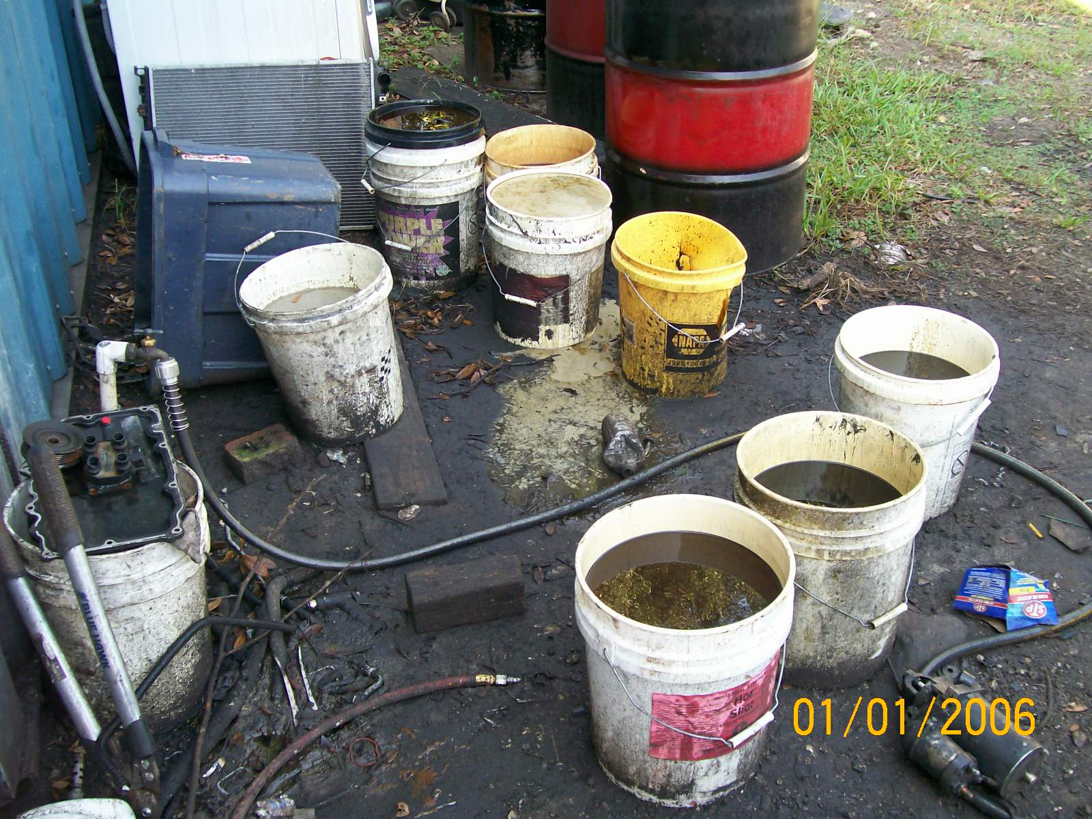
Prohibitions
62-710.401, F.A.C.
May not pour or spill used oil onto soil, waterways, storm drains, etc.
May not mix used oil with solid waste
Used oil may not be used for road oiling or weed control

Slide 4
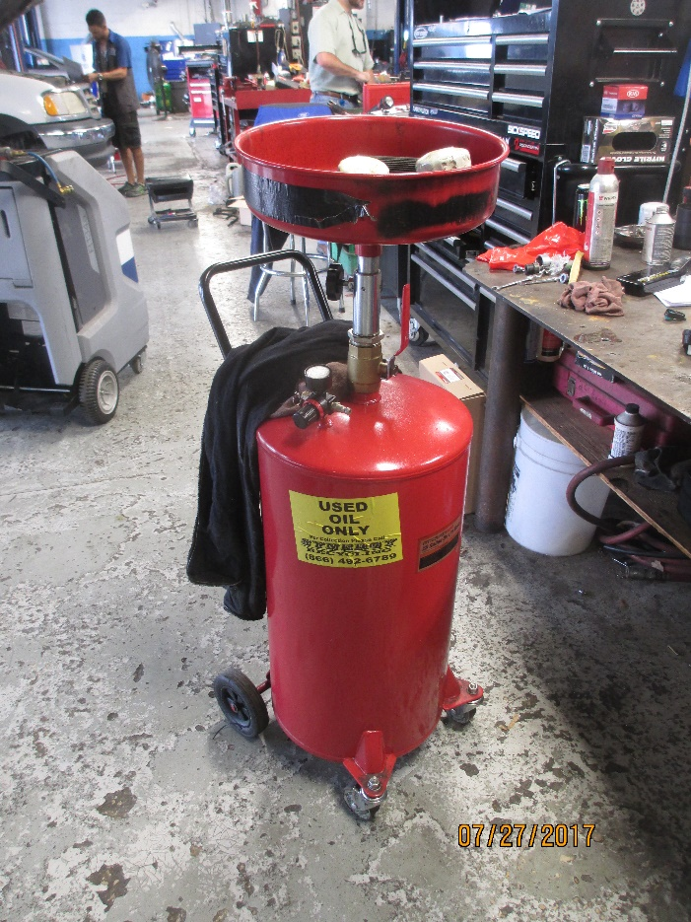
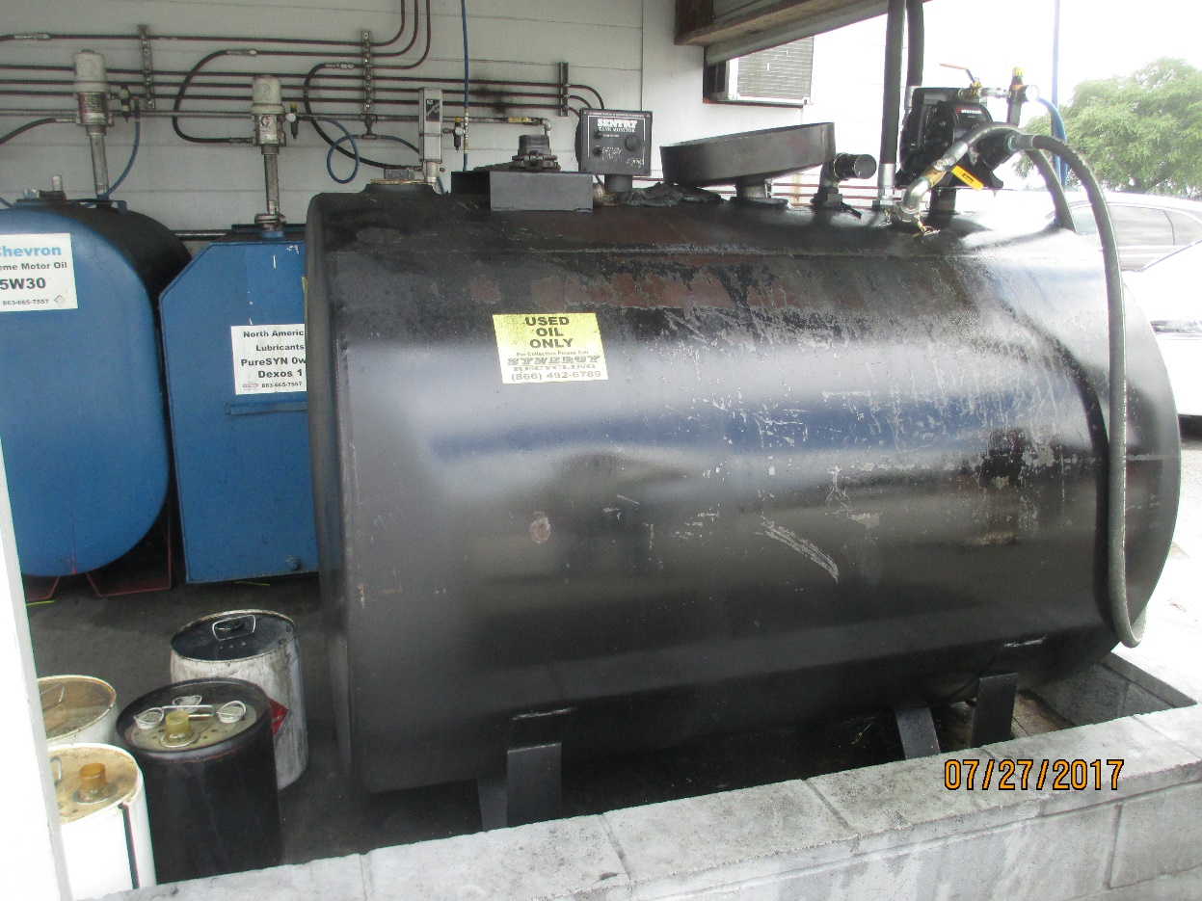
Used Oil Tanks and Containers
Used oil should be managed in tanks or containers
40 CFR 279.22(a)

Slide 5
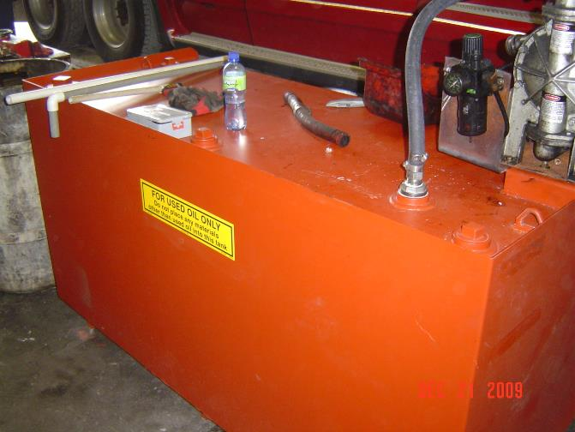
Used Oil Tank – Good Condition
40 CFR 279.22(b)
Notes:
40 CFR 279.22(b)
Tank should be in good condition

Slide 6
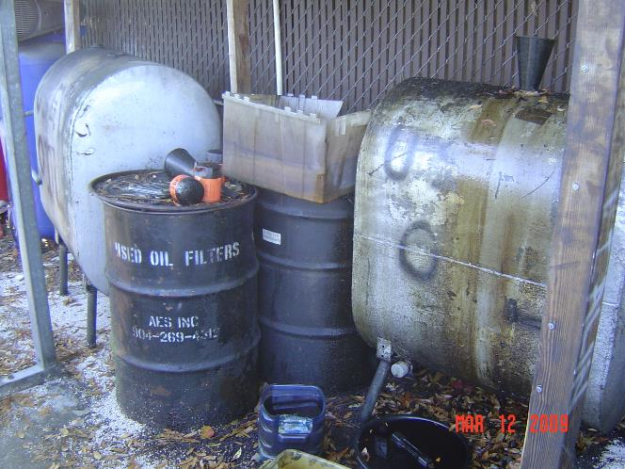
Used Oil Tank – Leaking
40 CFR 279.22(b)
Notes:
Tank in bad condition, leaking

Slide 7
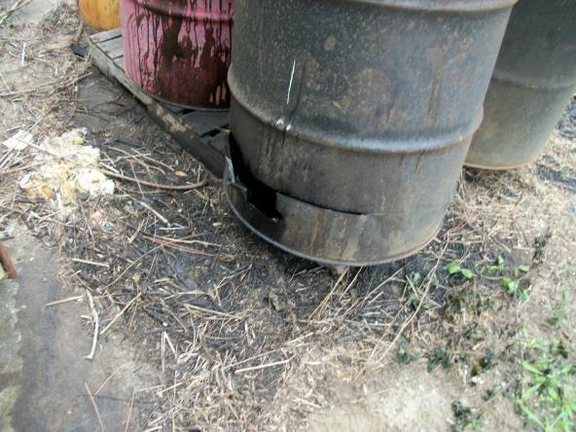
Used Oil Container – Leaking
40 CFR 279.22(b)
What else is wrong?

Slide 8
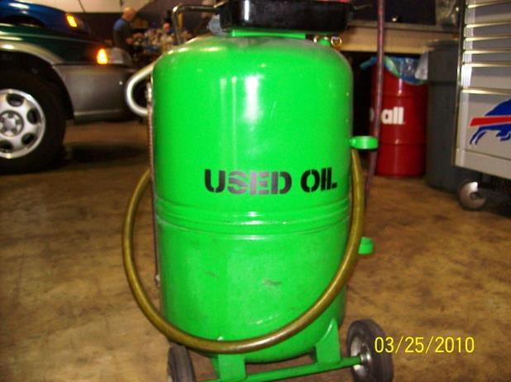
Used Oil Labels – Good
40 CFR 279.22(c)
Clearly labeled used oil
Notes:
40 CFR 279.22(c)
All used oil containers and tanks should be labeled with the words “used oil”

Slide 9
Used Oil – Releases
40 CFR 279.22(d)
Releases of used oil:
(1) Stop the release;
Contain the released used oil;
Clean up and manage properly the released used oil and other materials; and
(4) If necessary, repair or replace any leaking used oil storage container or tanks prior to returning them to service.
Notes:
40 CFR 279.22(d)

Slide 10
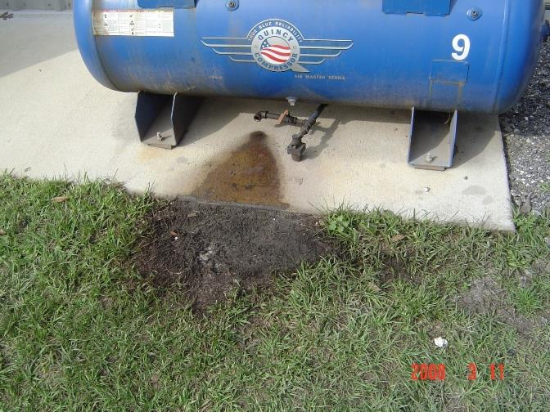
Used Oil – Releases
40 CFR 279.22(d)
Don’t
Notes:
Release from equipment

Slide 11
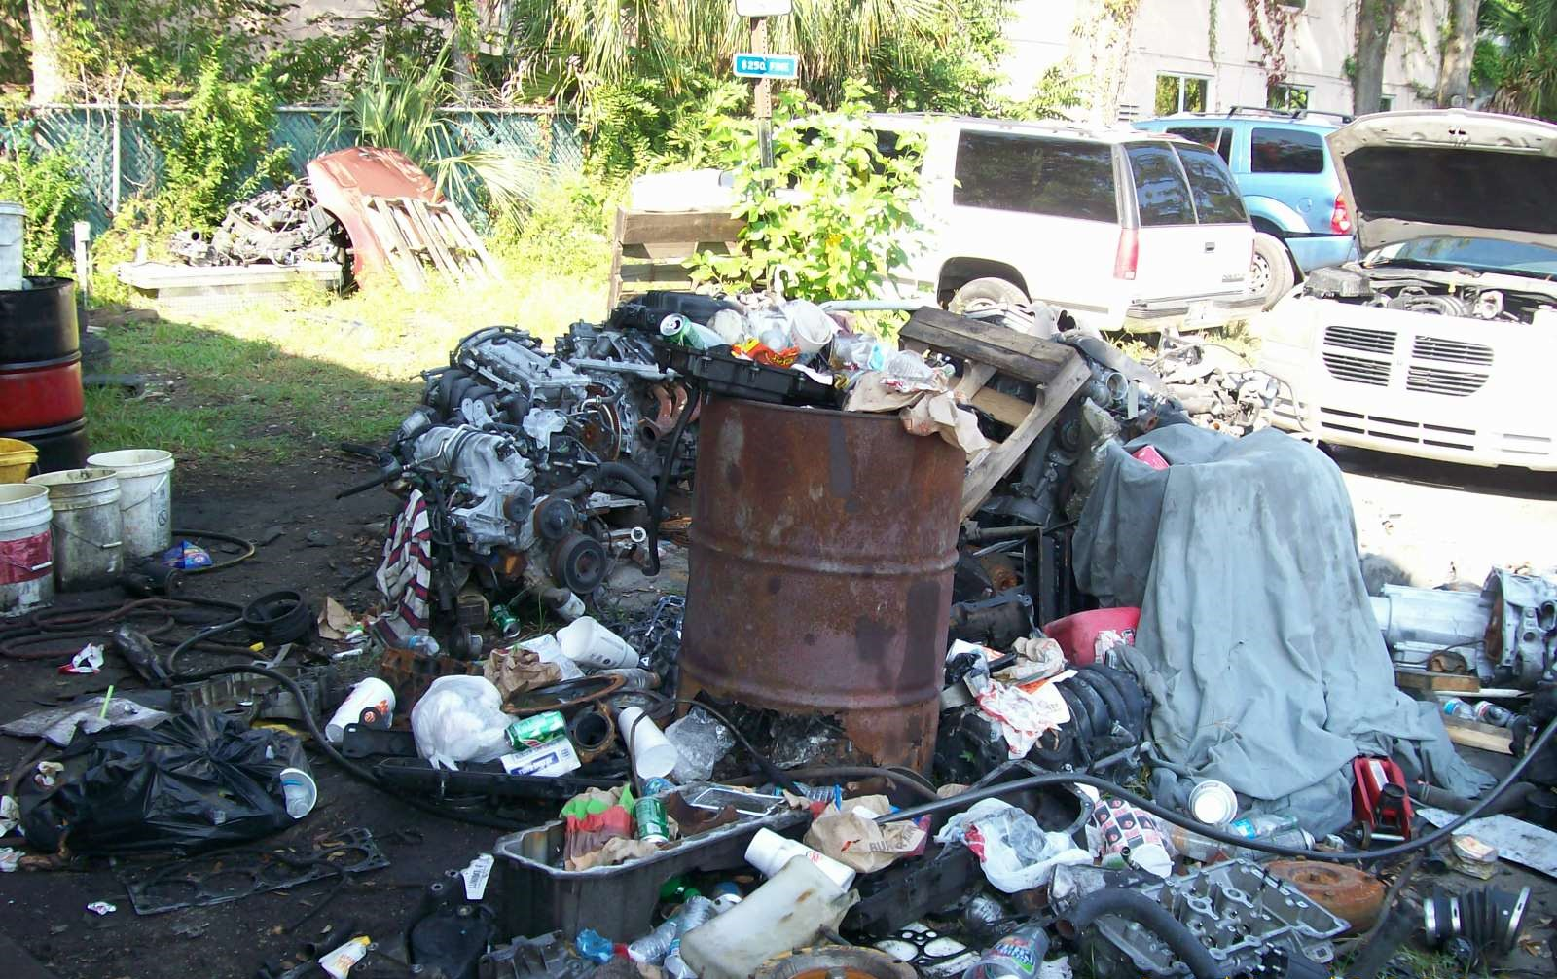
Used Oil Spill/Leak Response
40 CFR 279.22(d)
Don’t
Notes:
Engines / parts and containers of oil stored outside on dirt – now saturated with oil. NO effort to clean up or prevent further spills.

Slide 12
Secondary Containment
62-710.401(6), F.A.C.
If tanks or containers are not stored inside a structure, the contents shall be closed, covered or otherwise protected from the weather
If tanks or containers are not double-walled, they shall be stored on an oil-impermeable surface such as sealed concrete or asphalt
And must have secondary containment which has the capacity to hold 110% of the volume of the largest tank or container within the containment area

Slide 13
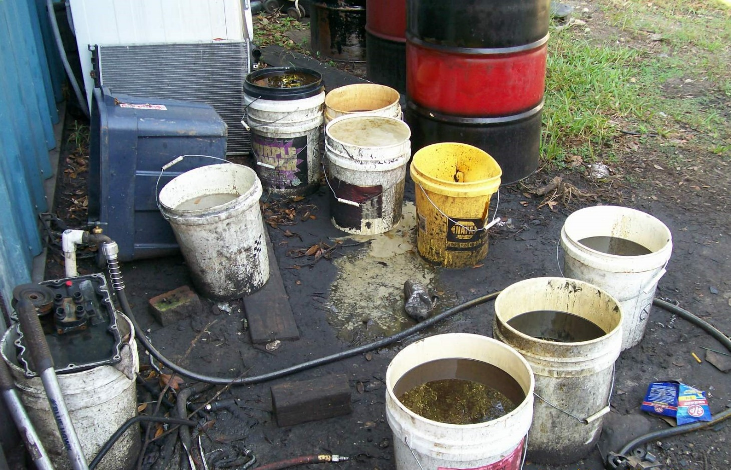
Used Oil Container – Outside Open
62-710.401(6), F.A.C.
Not closed, covered or otherwise protected from the environment, or on an oil-impermeable surface
Notes:
Open buckets and drums outside have overflowed onto ground.

Slide 14
Secondary Containment – Good
62-710.401(6), F.A.C.
Notes:
This secondary containment structure is large enough and has been sealed on the inside.

Slide 15
Secondary Containment
Bad – full of water/oil – 62-710.401(6), F.A.C.

Slide 16
Secondary Containment – Leaking
62-710.401(6), F.A.C.
Notes:
Note: the leak along the crack and onto the soil. Also, the concrete secondary containment structure has not been sealed.

Slide 17
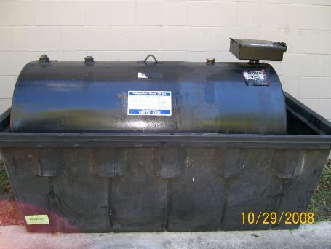
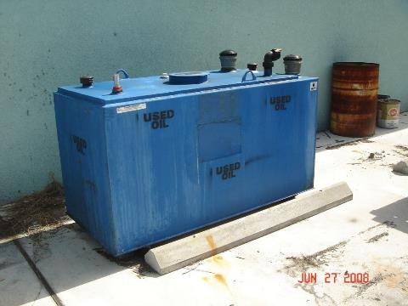
Used Oil – Outside
Not double-walled, but
in secondary containment.
Double-walled - 62-710.401(6), F.A.C.
Notes:
If outside – 62-710.401(6), FAC – double-walled or secondary containment, on an oil impermeable surface

Slide 18
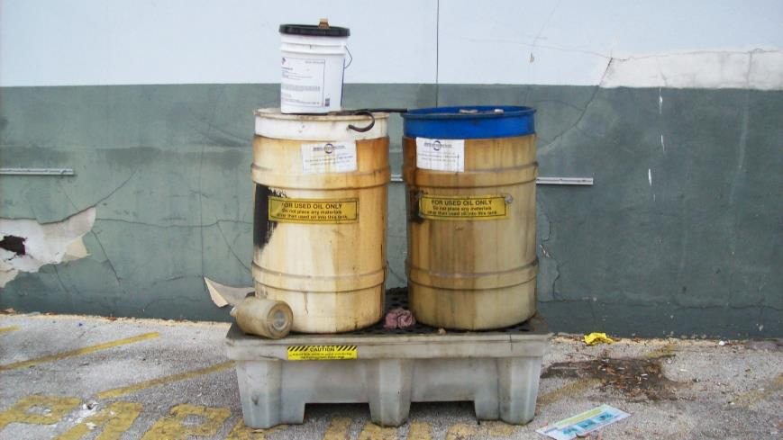
Used Oil – Outside Don’t
Bad – ½ full of water/oil – 62-710.401(6), F.A.C.
Notes:
If outside – 62-710.401(6), FAC – double-walled or secondary containment, on an oil impermeable surface

Slide 19
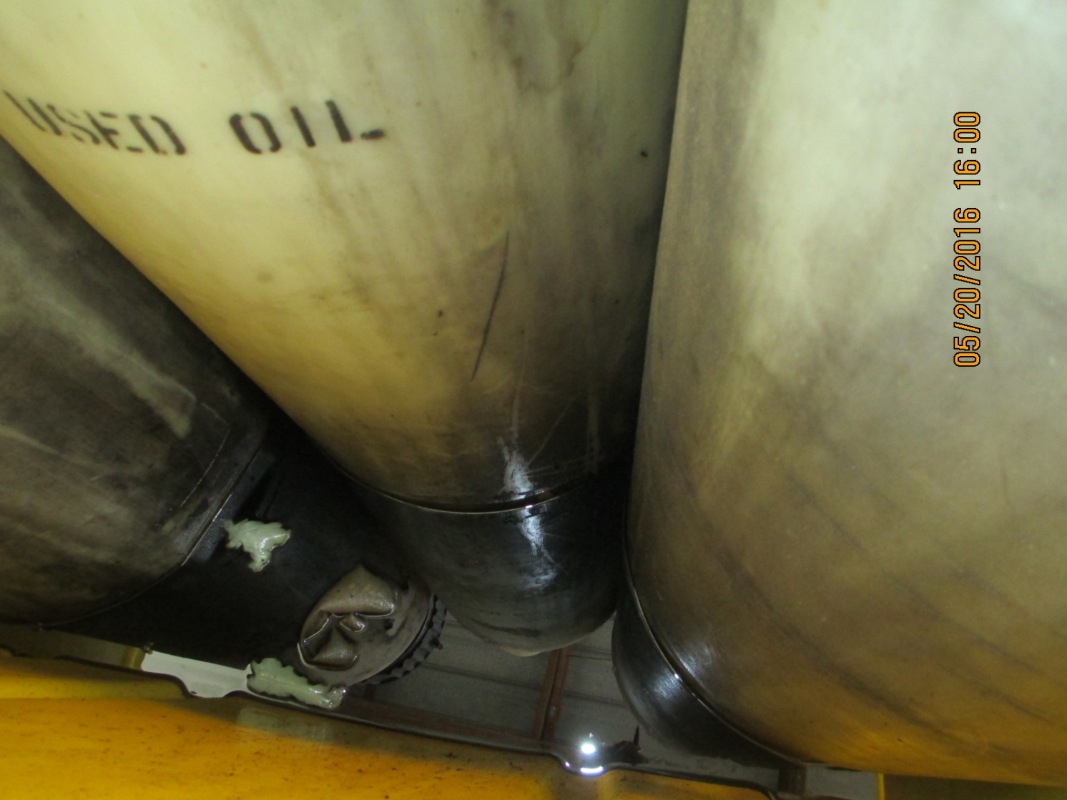
Used Oil – Outside Don’t
Bad – contains water/oil – 62-710.401(6), F.A.C.
Notes:
Secondary containment must be free of oil and water.
If a sheen, can not drain the rain water. Must manage as used oil or oily waste water

Slide 20
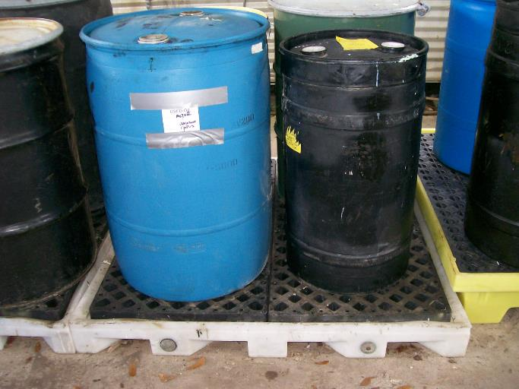
Used Oil – Not Adequate Secondary Containment
Bad – not 110 % - 62-710.401(6), F.A.C.
Notes:
This secondary containment is too small, it is not 110% of the 55-gallon drum (60 gallons).

Slide 21
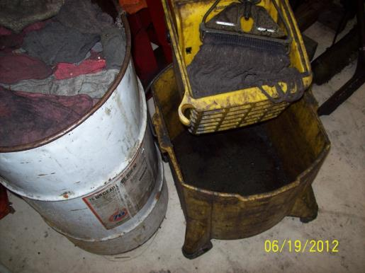
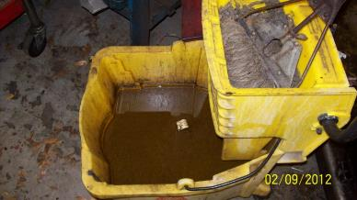
Oily Mop Water
Manage as used oil or oily water
Cannot discharge to septic tank
Cannot dump outside

Slide 22
Oily Mop Water – Don’t
Bad – release - 40 CFR 279.22(d)
Notes:
This facility was discharging oily mop water to the ground.

Slide 23
Used Oil Filter Requirements
Management
62-710.850(5), F.A.C.
Used oil filters must be managed in containers that are:
In good condition and not leaking
Stored covered or inside
Labeled “Used Oil Filters”
Stored on an oil impervious surface
Notes:
62-710.850(5)

Slide 24
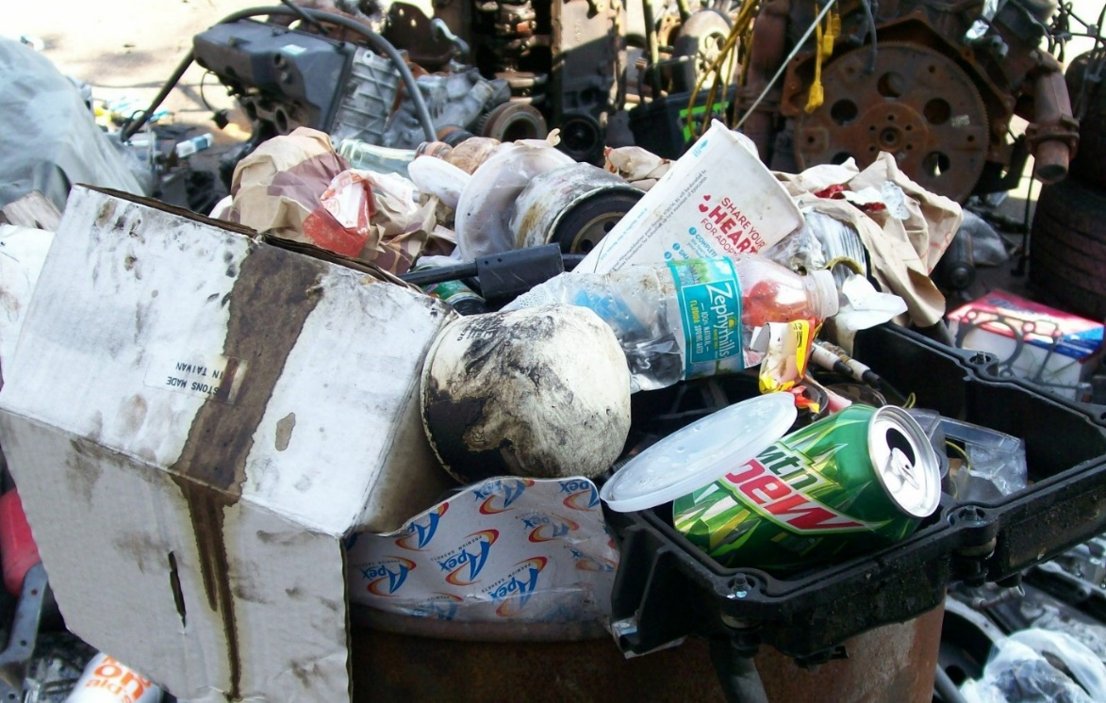
Used Oil Filter Requirements
Bad – used oil filters in trash – 62-710.850(1), F.A.C.
Notes:
UOFs can not be thrown into the trash.

Slide 25
Used Oil Filter Storage – Bad
Bad – open, no label, not on an oil-impervious surface –
62-710.850(5)(a), F.A.C.
Notes:
This container is not on an oil-impermeable surface, is not labeled, and is not covered/closed.

Slide 26
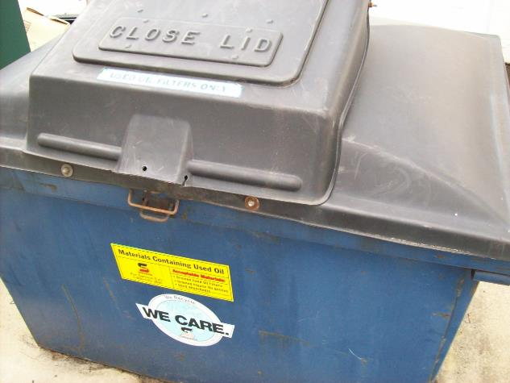
Used Oil Filter Requirements – Good Condition
Good - in good condition, not leaking, closed, labeled –62-710.850(5)(a), F.A.C.
Notes:
UOF container in good condition

Slide 27
Used Oil Filter Requirements – Good
Good – properly labeled – 62-710.850(5)(a), F.A.C.
Notes:
UOF properly labeled drum

Slide 28
Used Oil Filter Storage – Good
Good – on an oil impermeable surface, closed, labeled
Notes:
UOF drum on an oil impervious surface

Slide 29
Used Oil/Used Oil Filter Disposal Records
Used oil/used oil filter records should include:
Transportation by a registered transporter
Amount of shipment
Date of shipment
Used oil/used oil filter records should be kept for at least three years

Slide 30
Used Antifreeze BMPs
Any facility generating spent antifreeze becomes an antifreeze generator
Antifreeze must either be recycled (either on-site or off-site) or characterized pursuant to 40 CFR 262.11 to see if it is a hazardous waste
Notes:
Mini TCLP for antifreeze – lead, benzene, and perc.

Slide 31
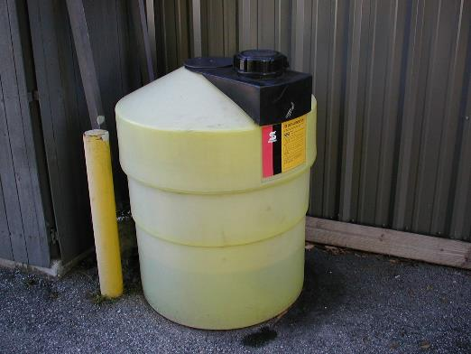
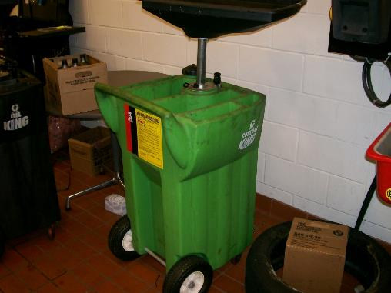
Used Antifreeze Container
Good containers
Notes:
Good antifreeze containers

Slide 32
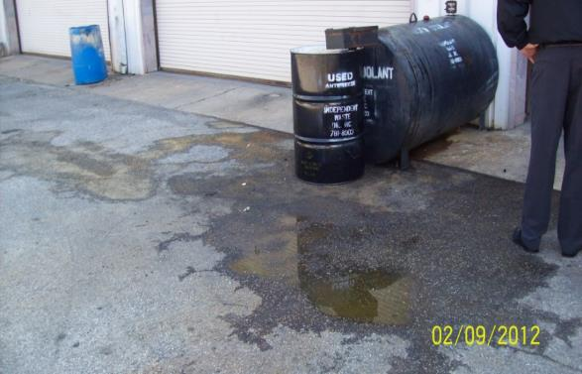
Antifreeze Spill/Leak Response
Spills or leaks of spent antifreeze must be addressed immediately:
Stop leak
Clean up affected area
Properly manage impacted material or soil
Repair tank or container or remove from service
Notes:
This large spill of antifreeze had not been addressed.

Slide 33
Universal Waste –
SQH Requirements
(Batteries, bulbs and devices only)
(Pesticides and pharmaceuticals not covered in these slides.)

Slide 34
Universal Waste
40 CFR Part 273
Waste Batteries (40 CFR 273.2)
Waste Pesticides - “Suspended and Recalled Pesticides” (40 CFR 273.3)
Waste Mercury-Containing Devices (40 CFR 273.4)
Waste Mercury-Containing Lamps (40 CFR 273.5)
Rule 62-730.186, F.A.C.
Waste Pharmaceuticals (Universal Pharmaceutical Waste rule)
Rule 62-737, F.A.C.
Spent mercury-containing lamps and devices
Notes:
Each category has slightly different requirements

Slide 35
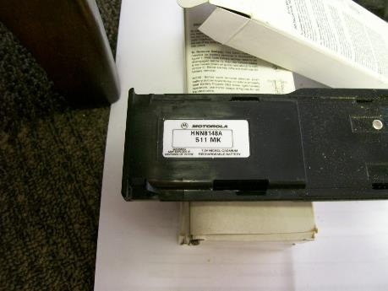
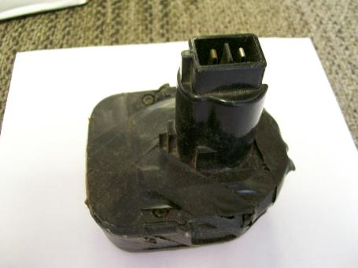
Examples of Universal Waste -Batteries
Batteries should be HW first

Slide 36
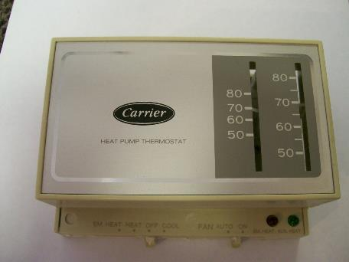
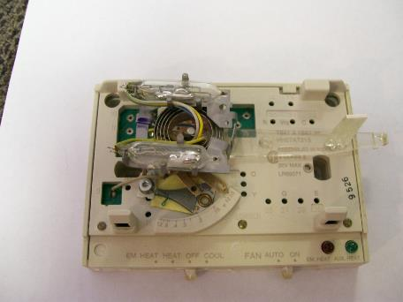
Examples of Universal Waste – Mercury-Containing Equipment

Slide 37
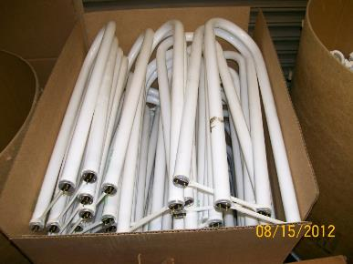
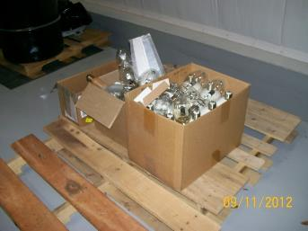
Examples of Universal Waste – Mercury-Containing Lamps
Notes:
Green tips do contain mercury!

Slide 38
Universal Waste (UW) Handlers
Small Quantity Handler (SQHs) [40 CFR 273 Subpart B]
Does not accumulate 5,000 kilograms or more of universal waste (batteries, pesticides, mercury-containing equipment, or lamps) at any time
Not required to notify DEP or obtain an EPA ID number
Large Quantity Handlers (LQHs) [40 CFR 273 Subpart C]
Accumulates 5,000 kilograms or more of total universal waste (batteries, pesticides, mercury-containing equipment, or lamps) at any time
Designation is retained through the end of the calendar year
Required to notify DEP and obtain an EPA ID number
Note: If managed as UW, waste does not count towards HW generator status

Slide 39
Prohibitions
40 CFR 273.11
SQHs of universal waste may not
Dispose of the universal waste (cannot throw in solid waste trash or other means of disposal)
Treat or dilute universal waste, except by responding to a release

Slide 40
Management
Battery Management (SQH)
40 CFR 273.13 (a) – Must be managed in a way to prevent release
Contain batteries that show signs of leakage
Container must be closed, sealed, and structurally sound
Compatible with the battery type and lack evidence of spillage or leakage
May conduct the following activities as long as each individual battery cell remains intact and closed:
Sort batteries by type
Properly discharge batteries
Regenerate used batteries
Properly remove and manage electrolyte (additional regulations apply)
Notes:
SQHs are not exempt from USDOT standards regarding battery shipments

Slide 41
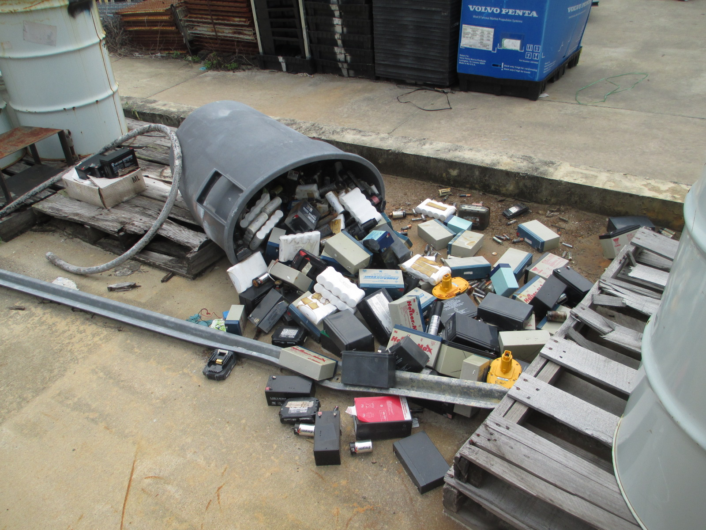
Improper Management
Notes:
This container had fallen over AFTER the pallet had rotted and they didn’t attempt to clean-up the UW spill.

Slide 42
Proper Management

Slide 43
Management
Mercury-Containing Equipment Management
40 CFR 273.13(c) – Must be managed in a way to prevent release
Contain equipment that shows evidence of leakage
Container must be closed, sealed, and structurally sound
Compatible with the equipment type and lack evidence of spillage or leakage
Must be reasonable capable of preventing release of mercury by any means
May conduct the following activities as long as mercury is not allowed to escape:
Remove and manage ampules
They are removed and managed in a proper manner
They are removed over or in a containment device
There is a mercury clean-up system in place
Spills are managed properly
It is ensured the area is well ventilated and monitored
Proper employee training is ensured
Removed ampules are stored in proper containers with adequate packing material
A hazardous waste determination will be performed on clean-up waste or equipment and then properly managed based upon the determination
Remove mercury from original housing (additional regulations apply)

Slide 44
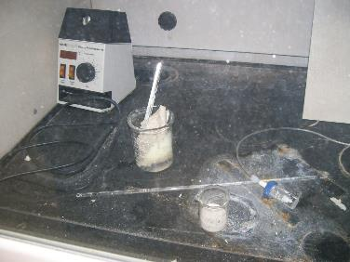
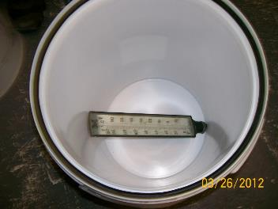
Improper Management
Notes:
Open containers and broken mercury thermometers. Also, note the thermostat mixed in with the batteries. This one has mercury ampules in it.

Slide 45
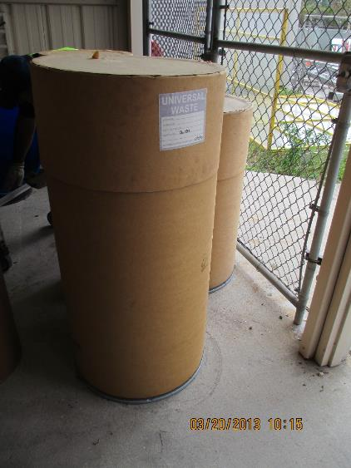
Proper Management
Notes:
Closed, properly labeled and dated container.

Slide 46
Management
Mercury Containing Lamps Management
40 CFR 273.13(d) – Must be managed in a way to prevent release
Contain ANY lamp (leaking or non-leaking)
Container must be closed, sealed, and structurally sound to prevent breakage
Compatible with the lamp type and lack evidence of spillage or leakage
Must be reasonable capable of preventing release of mercury by any means
Must immediately clean up and place into a container any lamp that is broken or shows signs of leakage

Slide 47
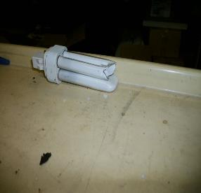
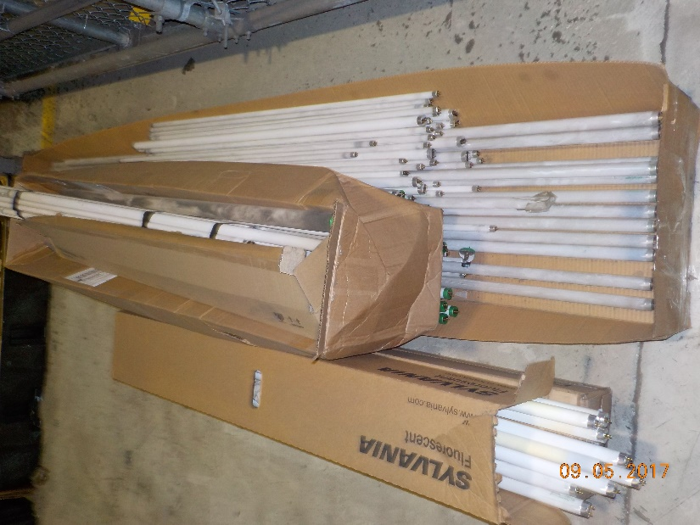
Improper Management

Slide 48
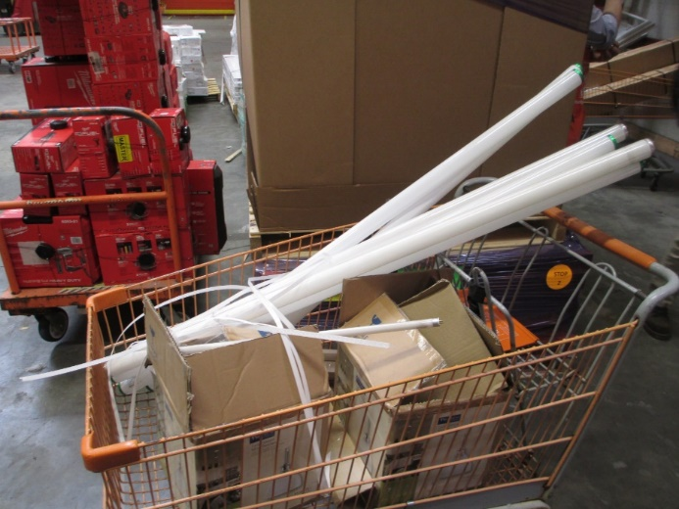
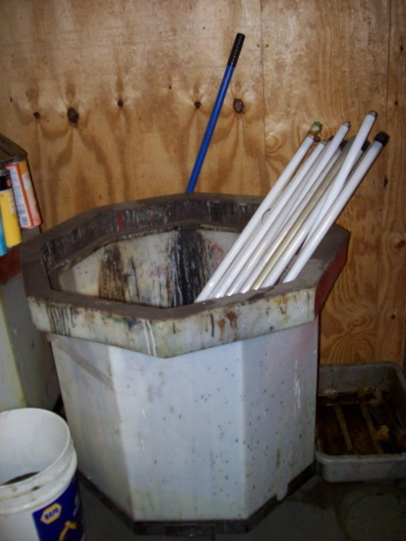
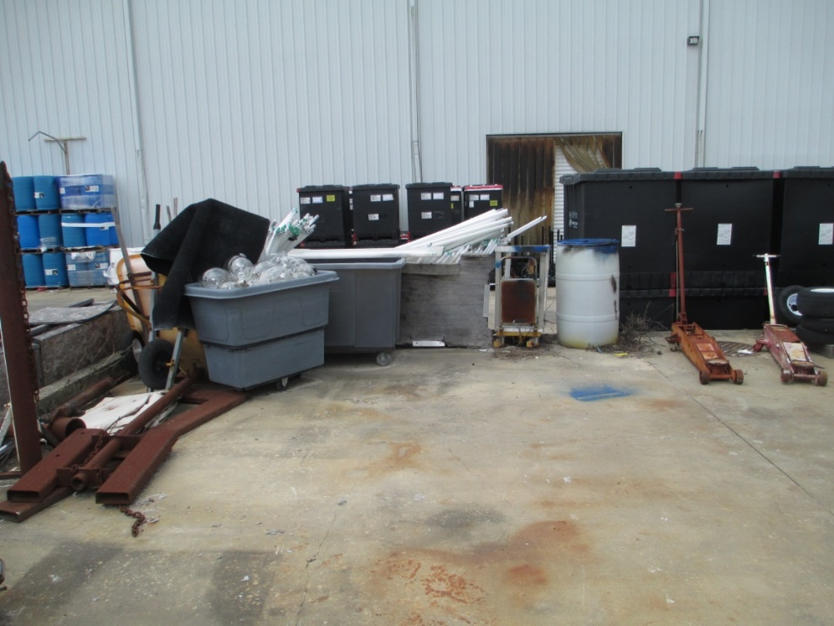
Improper Management
Notes:
Bulbs not in a container, broken bulbs on the ground are examples of improper management.

Slide 49
Proper Management
Notes:
Closed, properly labeled and dated containers.
The facility may want to store these on their sides, however, because they could fall over and the lamps inside may break.

Slide 50
Labeling
Batteries
SQHs – 40 CFR 273.14(a)
“Universal Waste–Battery(ies)”
“Waste Battery(ies)”
“Used Battery(ies)”
Mercury-Containing Equipment
SQHs – 40 CFR 273.14(d)
“Universal Waste–Mercury-Containing Equipment”
“Waste Mercury-Containing Equipment”
“Used Mercury-Containing Equipment”
If container contains ONLY thermostats, may replace “Mercury-Containing Equipment” with the word “Thermostats”
Mercury-Containing Lamps
SQHs – 40 CFR 273.14(e)
“Universal Waste Mercury-Containing Lamps”
“Waste Mercury-Containing Lamps”
“Used Mercury-Containing Lamps”

Slide 51
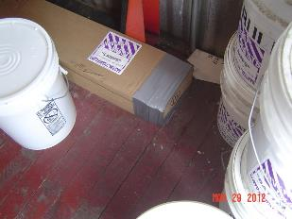
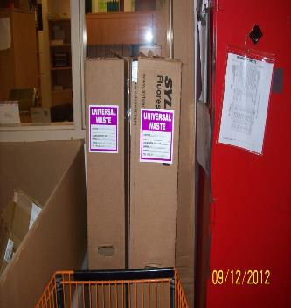
Labeling
Notes:
Closed, properly labeled and dated containers.

Slide 52
Accumulation Time Limit
SQHs may accumulate universal waste for no longer than one year [40 CFR 273.15 (a - c)]
May accumulate longer IF accumulation is solely for the purposes of accumulation of such quantities necessary to facilitate proper recovery, treatment, or disposal (handler bears burden of proof)
Must be able to demonstrate length of accumulation time
Marking or labeling container
Marking or labeling each individual item
Maintaining an inventory system
Marking the accumulation area
Any other method which clearly demonstrates the length of accumulation

Slide 53
Accumulation Time Limit
Notes:
This waste had been accumulating for longer than one year.

Slide 54
Personnel Training
SQHs - All employees that handle UW should be trained in the proper handling and emergency procedures appropriate to the type of UW at the facility
40 CFR 273.16

Slide 55
Personnel Training
Notes:
Personnel training might be cited if employees intentionally break or dispose of spent bulbs.

Slide 56
Response to Release
SQHs must:
Immediately contain releases
Perform a hazardous waste determination on residues from releases and properly manage residues
40 CFR 273.17 (a and b)

Slide 57
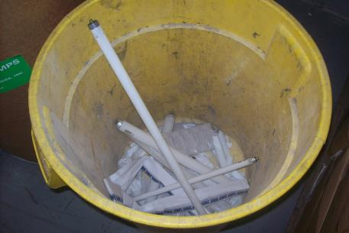
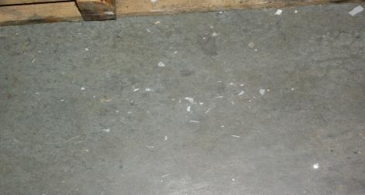
Improper Response to Release
Notes:
Broken bulbs should be managed in closed, properly labeled and dated containers.

Slide 58
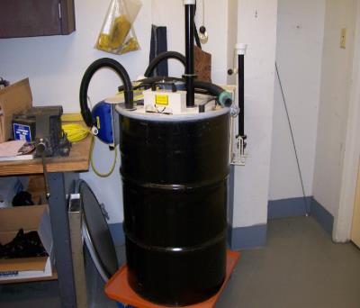
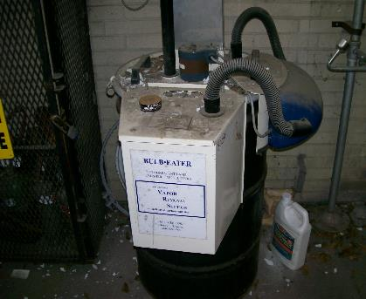
Lamp Crushers
A side note…
Lamp crushers should remain closed when not in use
Area around crusher should be monitored for release, and all releases should be immediately responded to
Notes:
Make sure bulb crusher is closed, that the filter receives proper maintenance, and that there is no broken glass on the floor around or on top of the bulb crusher. The bulb crusher should be one that is purchased. Be wary of home-made bulb crushers.
62-737.400(6), FAC – Also be reminded that we don’t allow them for anyone except the generator and a permitted destination facility. Improper maintenance may expose the employee to mercury.
Crushed lamps are still regulated, as the filter does not make the crushed lamps non-hazardous.

Slide 59
Off-Site Shipments
SQHs must:
Send UW only to a UW handler, destination facility, or foreign destination
May self-transport if complying with transporter requirements in subpart D
Comply with U.S. DOT requirements if UW is a hazardous material
Before shipment, ensure that it will be received
Rejection of shipment
If shipment is rejected, receive it back or ship to another destination facility
If rejecting a shipment, contact originating handler, ship to originating handler or to another destination facility
If shipment received is hazardous waste and not UW, notify EPA/DEP
If shipment received is non-hazardous, but not UW, the waste may be managed appropriately
40 CFR 273.18 (a – h)

Slide 60
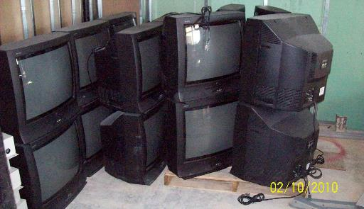
Electronic Waste
E-waste is the term used to describe end-of-life electronics
Computers and televisions are specifically targeted for recycling because of the high levels of lead found in their cathode ray tubes (CRTs)
Notes:
E-waste is not included in the list of universal wastes at this time. We have chosen not to regulate e-waste demanufacturing operations as hazardous waste management facilities. However, many of these products contain universal waste lamps, mercury switches, universal waste batteries, as well as other conditionally excluded materials such as cathode ray tubes and printed circuit boards. Collectors and demanufacturers should manage these items properly.

Slide 61
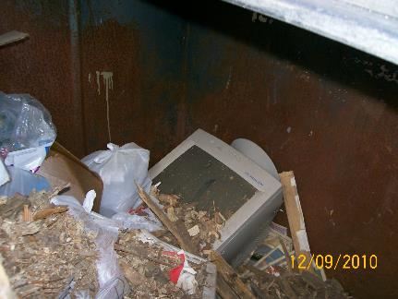
Improper Management – E-Waste
Notes:
Electronic waste may be hazardous waste due to elevated levels of heavy metals. CRTs in the trash is usually cited as improper disposal of hazardous waste due to the lead content of the glass.
Stored electronic waste can be considered “speculative accumulation”. These should not be stored longer than a year.
These items should be properly recycled.

Slide 62
Questions?
Contact Compliance Assurance
Hazardous Waste
Northeast District
8800 Baymeadows Way West
Suite 100 Jacksonville, Florida 32256 (904) 256-1700 phone (904) 256-1588 fax

